Slide 1
Link to Exam Paper
Focused Retrieval Strategy
Model Using Retrieval Information
Assess Using Mark Scheme
Independent Practice
Reflection
LO: to understand the context around Animal Farm and use terminology correctly.
Animal Farm
AP2
Skills required:
Understanding of plot and character
Language analysis
Awareness of social and historical context
Notes:
Starter/UTV:

Slide 2
15 March 2024
AP2 Revision – Animal Farm
Books out
Planners on desk on green page
Equipment out
Date, title and lesson goal underlined in your book
Notes:
Starter/UTV:

Slide 3
Link to Exam Paper
Focused Retrieval Strategy
Model Using Retrieval Information
Assess Using Mark Scheme
Independent Practice
Reflection
LO: to understand the context around Animal Farm and use terminology correctly.
How is Animal Farm an allegory for the Russian Revolution?
Let’s recap the term ‘allegory’. What do you understand this word to mean? What do you remember?
allegory
Notes:
Starter/UTV:

Slide 4
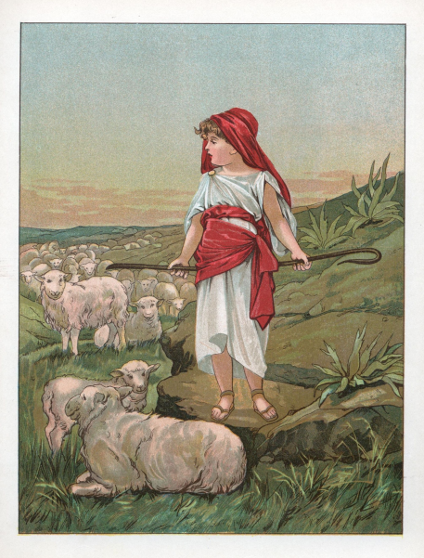
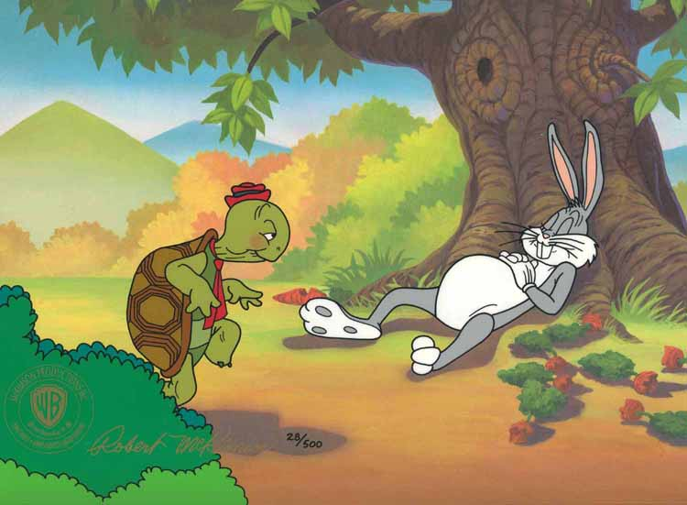
Link to Exam Paper
Focused Retrieval Strategy
Model Using Retrieval Information
Assess Using Mark Scheme
Independent Practice
Reflection
How is Animal Farm an allegory for the Russian Revolution?
LO: to understand the context around Animal Farm and use terminology correctly.
An allegory is a story with two meanings. It has a literal meaning, which is what actually happens in the story. But it also has a deeper meaning.
The deeper meaning is often a moral. It teaches you a lesson about life.
Some examples include ‘The tortoise and the hare’ and ‘The boy who cried wolf’.
Notes:
Starter/UTV:

Slide 5
Link to Exam Paper
Focused Retrieval Strategy
Model Using Retrieval Information
Assess Using Mark Scheme
Independent Practice
Reflection
How is Animal Farm an allegory for the Russian Revolution?
LO: to understand the context around Animal Farm and use terminology correctly.
'Animal Farm' has a number of different morals. Here are some of the morals we see in the novel:
The moral of 'Animal Farm' is that it if one group get too much power, they will abuse it.
The moral of 'Animal Farm' is that the most intelligent should lead and have power.
The moral of 'Animal Farm' is that it is important to question authority.
Notes:
Starter/UTV:

Slide 6
Link to Exam Paper
Focused Retrieval Strategy
Model Using Retrieval Information
Assess Using Mark Scheme
Independent Practice
Reflection
LO: to understand the context around Animal Farm and use terminology correctly.
How is Animal Farm an allegory for the Russian Revolution?
By writing an allegory, George Orwell wanted to show the reader the truth about what was happening in Russia.
Orwell wanted to show people how the leaders of Russia were treating their people.
Almost all of the events in 'Animal Farm' are an allegory for something that actually happened in Russia.
Notes:
Starter/UTV:

Slide 7
Link to Exam Paper
Focused Retrieval Strategy
Model Using Retrieval Information
Assess Using Mark Scheme
Independent Practice
Reflection
How is Animal Farm an allegory for the Russian Revolution?
Here are some of the parts of 'Animal Farm' that are an allegory for the Russian Revolution.
Animal Farm: The events that take place on the farm are examples of allegory for what happened in Russia.
The Rebellion: The animals’ Rebellion is an allegory for the Russian Revolution that took place in 1917.
Farmer Jones: The character of Jones is an allegory for Tsar Nicholas II. The people of Russia start the Russian Revolution to throw out Nicholas II, just like the animals threw out Farmer Jones.
Napoleon: The character of Napoleon is an allegory for Joseph Stalin.
Snowball: The character of Snowball is an allegory for Leon Trotsky.
Old Major: The character of Old Major combines the ideas of Karl Marx and Lenin.
Animalism: The idea of Animalism is an allegory for communism. In both Animalism and communism, the workers are treated fairly and everything is shared equally between the people.
Notes:
Starter/UTV:

Slide 8
Link to Exam Paper
Focused Retrieval Strategy
Model Using Retrieval Information
Assess Using Mark Scheme
Independent Practice
Reflection
Tsar Nicholas II -
 |  | Napoleon -
How is Animal Farm an allegory for the Russian Revolution?
Story board the events of the Russian Revolution by cutting up and placing the images in the correct boxes.
Add an explanation about the events in Animal Farm.
Notes:
Starter/UTV:

Slide 9
Link to Exam Paper
Focused Retrieval Strategy
Model Using Retrieval Information
Assess Using Mark Scheme
Independent Practice
Reflection
LO: to understand the context around Animal Farm and use terminology correctly.
How is Animal Farm an allegory for the Russian Revolution?
Here is how we refer to the context of the novella:
Animal Farm is an allegory as Orwell based the story on the real life events of the Russian Revolution. We know this because…
Tip: this could be used as an introductory sentence!
Notes:
Starter/UTV:

Slide 10
Link to Exam Paper
Focused Retrieval Strategy
Model Using Retrieval Information
Assess Using Mark Scheme
Independent Practice
Reflection
LO: to understand the context around Animal Farm and use terminology correctly.
Being able to write about context is important!
This is an extract from the GCSE English Literature mark scheme:
Notes:
Starter/UTV:

Slide 11
Link to Exam Paper
Focused Retrieval Strategy
Model Using Retrieval Information
Assess Using Mark Scheme
Independent Practice
Reflection
LO: to understand the context around Animal Farm and use terminology correctly.
How is Animal Farm an allegory for the Russian Revolution?
Now complete the paragraph.
Animal Farm is an allegory as Orwell based the story on the real life events of the Russian Revolution. We know this because…
Notes:
Starter/UTV:

Slide 12
Link to Exam Paper
Focused Retrieval Strategy
Model Using Retrieval Information
Assess Using Mark Scheme
Independent Practice
Reflection
Students should end the lesson with some form of reflection. That may be self or peer assessing independent practice against the mark scheme, or it could be a target setting of what they still need to focus upon in their revision.
Notes:
Starter/UTV:

Slide 13
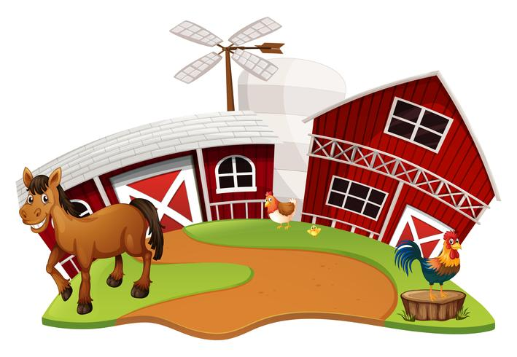
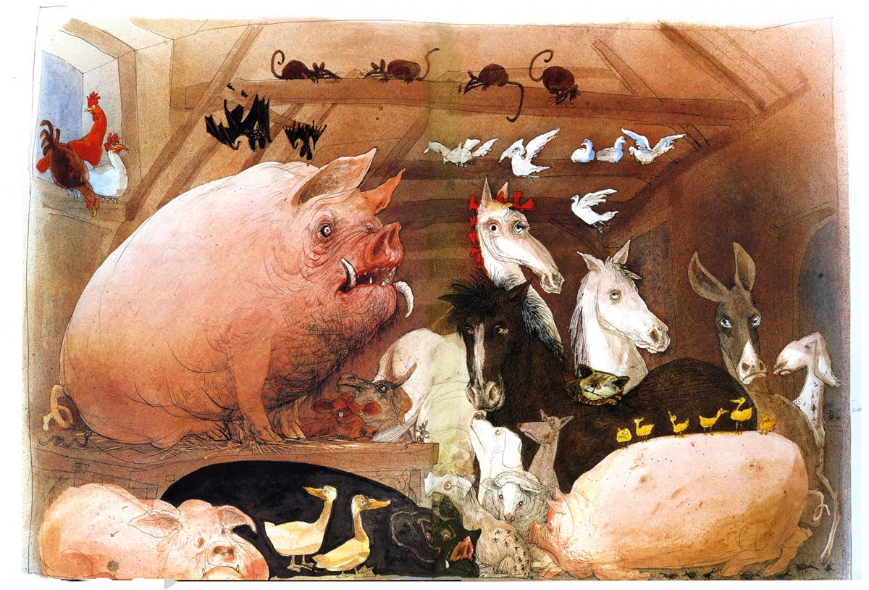
Link to Exam Paper
Focused Retrieval Strategy
Model Using Retrieval Information
Assess Using Mark Scheme
Independent Practice
Reflection
What is life like for the animals in the novella?
LO: to understand the characters in Animal Farm and analyse the text.
Create a mind map of everything you know about the animals.
Notes:
Starter/UTV:

Slide 14
Link to Exam Paper
Focused Retrieval Strategy
Model Using Retrieval Information
Assess Using Mark Scheme
Independent Practice
Reflection
What is life like for the animals in the novella?
LO: to understand the characters in Animal Farm and analyse the text.
The animals
Notes:
Starter/UTV:

Slide 15
Link to Exam Paper
Focused Retrieval Strategy
Model Using Retrieval Information
Assess Using Mark Scheme
Independent Practice
Reflection
What is life like for the animals in the novella?
LO: to understand the characters in Animal Farm and analyse the text.
Answer these questions in pairs:
Why do the animals start a rebellion?
Think of 3 adjectives to describe Mr Jones.
Old Major thinks that Jones has too much power over the animals and treats the animals in a cruel and unfair way.
Tyrant / alcoholic / uncaring / inefficient / neglectful / unappreciative / selfish
Notes:
Starter/UTV:

Slide 16
Link to Exam Paper
Focused Retrieval Strategy
Model Using Retrieval Information
Assess Using Mark Scheme
Independent Practice
Reflection
What is life like for the animals in the novella?
LO: to understand the characters in Animal Farm and analyse the text.
Put these statements in the correct order:
The animals make Old Major’s dream become a reality.
Orwell shows us that the animals on the farm are fed up with Jones, who they think is a tyrant.
Old Major has inspired the animals. He has given them a vision of a life without Man.
Manor Farm is theirs!
Notes:
Starter/UTV:

Slide 17
Link to Exam Paper
Focused Retrieval Strategy
Model Using Retrieval Information
Assess Using Mark Scheme
Independent Practice
Reflection
What is life like for the animals in the novella?
LO: to understand the characters in Animal Farm and analyse the text.
Let’s recap how their new society starts.
Let’s re-read to the end of the Chapter 1 from page 14:
‘For the first few minutes the animals could hardly believe in their good fortune’.
Notes:
Starter/UTV:

Slide 18
Link to Exam Paper
Focused Retrieval Strategy
Model Using Retrieval Information
Assess Using Mark Scheme
Independent Practice
Reflection
LO: to understand the characters in Animal Farm and analyse the text.
Methods
Connotations
“Their first act was to gallop in a body right round the boundaries of the farm, as though to make quite sure that no human being was hiding anywhere upon it”
Effects on the reader
Writer’s intentions
Notes:
Starter/UTV:

Slide 19
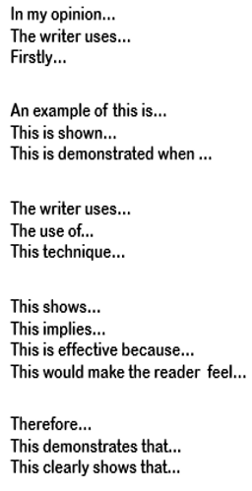
Link to Exam Paper
Focused Retrieval Strategy
Model Using Retrieval Information
Assess Using Mark Scheme
Independent Practice
Reflection
Clearly sum up your opinion you are exploring in your paragraph
LO: to understand the characters in Animal Farm and analyse the text.
How does Orwell present the animals’ reactions after the rebellion?
Embed a relevant quotation to support the point you are making
Identify the technique the writer has used, including key terminology
Analyse your quotation thoroughly by considering the author and reader
Finally, link this paragraph back to the question!
Notes:
Starter/UTV:

Slide 20
Link to Exam Paper
Focused Retrieval Strategy
Model Using Retrieval Information
Assess Using Mark Scheme
Independent Practice
Reflection
Clearly sum up your opinion you are exploring in your paragraph
Orwell presents the animals as overjoyed when they take control of the farm.
LO: to understand the characters in Animal Farm and analyse the text.
Embed a relevant quotation to support the point you are making
We can support this with the following quotation: …
Identify the technique the writer has used, including key terminology
Orwell has used a … here.
Analyse your quotation thoroughly by considering the author and reader
This helps us to understand … as … has connotations of…
Finally, link this paragraph back to the question!
The reader may feel that the animals…
Notes:
Starter/UTV:

Slide 21
Link to Exam Paper
Focused Retrieval Strategy
Model Using Retrieval Information
Assess Using Mark Scheme
Independent Practice
Reflection
Clearly sum up your opinion you are exploring in your paragraph
How does Orwell present the animals’ reactions after the rebellion?
Embed a relevant quotation to support the point you are making
Identify the technique the writer has used, including key terminology
Analyse your quotation thoroughly by considering the author and reader
Finally, link this paragraph back to the question!
Notes:
Starter/UTV:

Slide 23
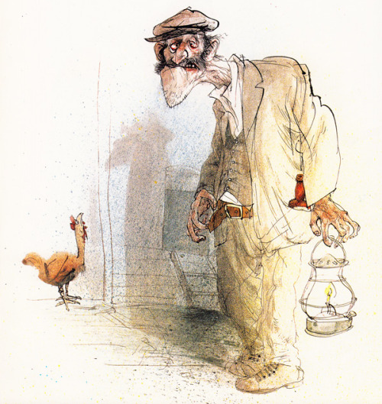
Link to Exam Paper
Focused Retrieval Strategy
Model Using Retrieval Information
Assess Using Mark Scheme
Independent Practice
Reflection
What is life like for the animals in the novella?
LO: to understand the characters in Animal Farm and analyse the text.
What do you remember about Farmer Jones?
Notes:
Starter/UTV:

Slide 24
Link to Exam Paper
Focused Retrieval Strategy
Model Using Retrieval Information
Assess Using Mark Scheme
Independent Practice
Reflection
What is life like for the animals in the novella?
LO: to understand the characters in Animal Farm and analyse the text.
How do the pigs start the rebellion?
They arrange a meeting with Jones, the farmer
One of the cows breaks the door of the store shed
They arrange secret meetings and teach the principles of Animalism
They convince the other animals that Sugarcandy Mountain is real
They convince Boxer and Clover to spread their message and teachings of Animalism to the others
Notes:
Starter/UTV:

Slide 25
Link to Exam Paper
Focused Retrieval Strategy
Model Using Retrieval Information
Assess Using Mark Scheme
Independent Practice
Reflection
LO: to understand the characters in Animal Farm and analyse the text.
Methods
Connotations
“…they raced back to the farm buildings to wipe out the last traces of Jones's hated reign.”
Effects on the reader
Writer’s intentions
Notes:
Starter/UTV:

Slide 26
Link to Exam Paper
Focused Retrieval Strategy
Model Using Retrieval Information
Assess Using Mark Scheme
Independent Practice
Reflection
Clearly sum up your opinion you are exploring in your paragraph
LO: to understand the characters in Animal Farm and analyse the text.
How does Orwell present the animals’ reactions after the rebellion?
Embed a relevant quotation to support the point you are making
Identify the technique the writer has used, including key terminology
Analyse your quotation thoroughly by considering the author and reader
Finally, link this paragraph back to the question!
Notes:
Starter/UTV:

Slide 27
Link to Exam Paper
Focused Retrieval Strategy
Model Using Retrieval Information
Assess Using Mark Scheme
Independent Practice
Reflection
Clearly sum up your opinion you are exploring in your paragraph
Orwell presents the animals as overjoyed when they take control of the farm.
LO: to understand the characters in Animal Farm and analyse the text.
Embed a relevant quotation to support the point you are making
We can support this with the following quotation: …
Identify the technique the writer has used, including key terminology
Orwell has used … here.
Analyse your quotation thoroughly by considering the author and reader
This helps us to understand … as … has connotations of…
Finally, link this paragraph back to the question!
The reader may feel that the animals…
Notes:
Starter/UTV:

Slide 28
Link to Exam Paper
Focused Retrieval Strategy
Model Using Retrieval Information
Assess Using Mark Scheme
Independent Practice
Reflection
Clearly sum up your opinion you are exploring in your paragraph
LO: to understand the characters in Animal Farm and analyse the text.
How does Orwell present the animals’ reactions after the rebellion?
Embed a relevant quotation to support the point you are making
Identify the technique the writer has used, including key terminology
Analyse your quotation thoroughly by considering the author and reader
Finally, link this paragraph back to the question!
Notes:
Starter/UTV:

Slide 29
Link to Exam Paper
Focused Retrieval Strategy
Model Using Retrieval Information
Assess Using Mark Scheme
Independent Practice
Reflection
Independent Learning – AP2 Revision
Notes:
Starter/UTV:

Slide 30
Link to Exam Paper
Focused Retrieval Strategy
Model Using Retrieval Information
Assess Using Mark Scheme
Independent Practice
Reflection
Independent Learning – AP2 Revision
Notes:
Starter/UTV:

Slide 31
Link to Exam Paper
Focused Retrieval Strategy
Model Using Retrieval Information
Assess Using Mark Scheme
Independent Practice
Reflection
Independent Learning – AP2 Revision
Notes:
Starter/UTV:

