Slide 1
Year 8 AP2 Knowledge Organiser
March 2024

Slide 2
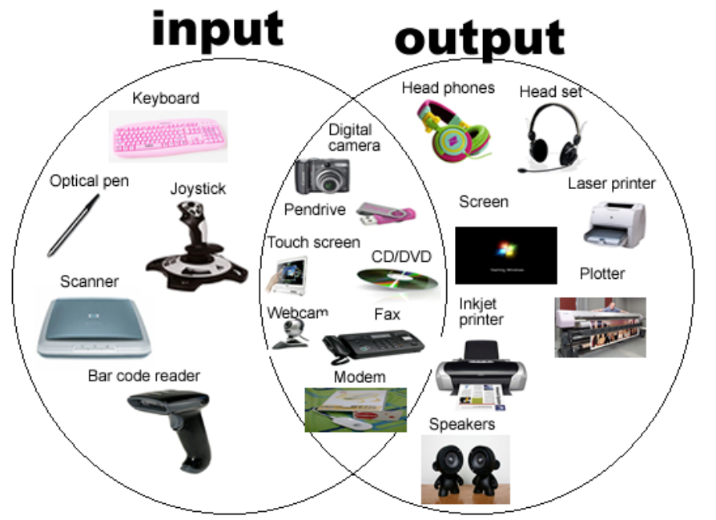
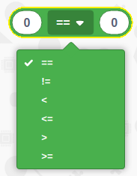
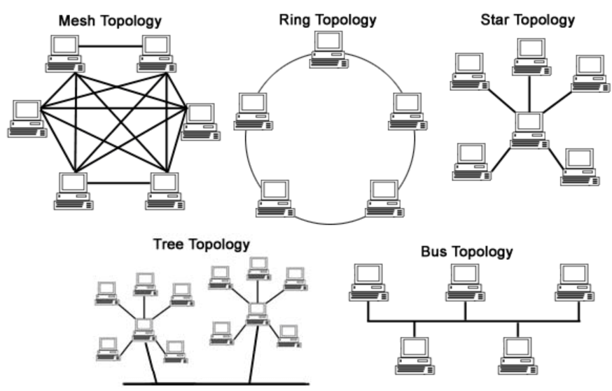
Year 8 AP2 revision topics
Data transmission via a network
Linking webpages
LAN
Networks
Algorithms
ISP’s
Domain names & URL’s
Computer connections
Outputs
Inputs
Network topologies
WAN
Denary conversion to Binary
Image resolution – Pixels
Sound waves
Values
VOIP
Difference between internet and WWW
Values are equal. Values must NOT be equal. Left value is less than right value. Left value is less than or equal to right value. Left value is greater than right value Left value is greater than or equal to right value.
Networks and network topologies

Slide 3
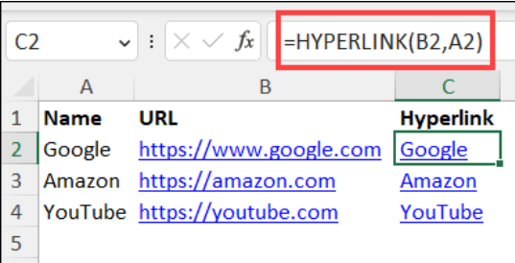
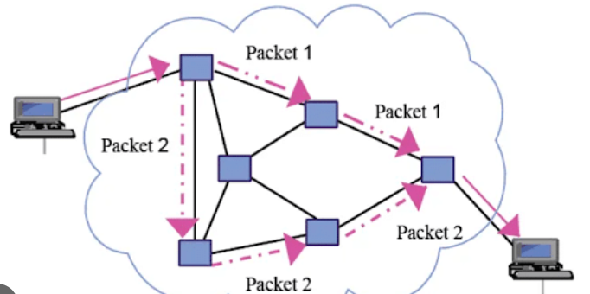
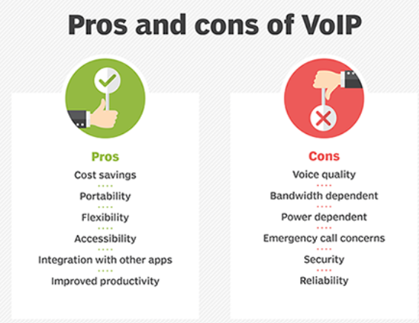
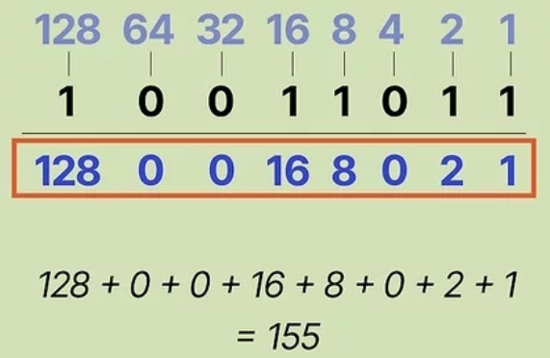
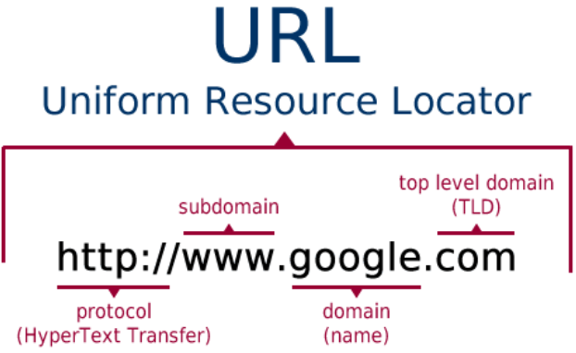
ISP’s
Data packets
Binary to Denary

Slide 4
