Slide 1
Link to Exam Paper
Focused Retrieval Strategy
Model Using Retrieval Information
Assess Using Mark Scheme
Independent Practice
Reflection
LO: to understand the context around Of Mice and Men and use terminology correctly.
Of Mice and Men
AP2
Skills required:
Understanding of plot and character
Language analysis
Awareness of social and historical context
Notes:
Starter/UTV:

Slide 2
15 March 2024
LO: to understand the context around Of Mice and Men and use terminology correctly.
AP2 Revision – Of Mice and Men
Books out
Planners on desk on green page
Equipment out
Date, title and lesson goal underlined in your book
Notes:
Starter/UTV:

Slide 3
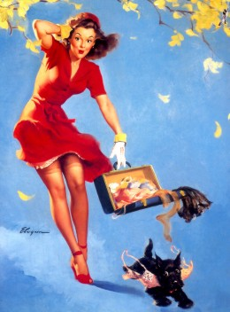
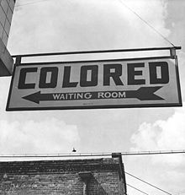
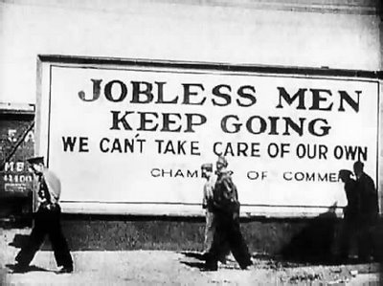
Link to Exam Paper
Focused Retrieval Strategy
Model Using Retrieval Information
Assess Using Mark Scheme
Independent Practice
Reflection
LO: to understand the context around Of Mice and Men and use terminology correctly.
What was society like in America during the 1930s?
Let’s recap the ‘context’ of the novella. What do you understand this to mean? What do you remember?
Context
Notes:
Starter/UTV:

Slide 4
Link to Exam Paper
Focused Retrieval Strategy
Model Using Retrieval Information
Assess Using Mark Scheme
Independent Practice
Reflection
LO: to understand the context around Of Mice and Men and use terminology correctly.
What was society like in America during the 1930s?
During the 1930s, life was unfair for many.
The Great Depression
Migrant workers
The American Dream
Racism and segregation
Sexism
How does Steinbeck reflect these issues in the novella?
Notes:
Starter/UTV:

Slide 5
Link to Exam Paper
Focused Retrieval Strategy
Model Using Retrieval Information
Assess Using Mark Scheme
Independent Practice
Reflection
What was society like in America during the 1930s?
Here are some of the ways that Of Mice and Men reflects America in the 1930s:
The boss and Curley: They are the more privileged characters in the story as they don’t do manual labour and have control over who works for them.
George, Lennie, Slim, Carlson, Whit: These characters represent the migrant workers of the period.
Lennie: A mentally disadvantaged character.
Candy: An old, physically disadvantaged character.
Curley’s wife: The only woman on the ranch.
Crooks: A black man who is segregated from the others. Slim treats Crooks with respect but others do not.
Notes:
Starter/UTV:

Slide 6
Link to Exam Paper
Focused Retrieval Strategy
Model Using Retrieval Information
Assess Using Mark Scheme
Independent Practice
Reflection
The boss and Curley
 |  | Crooks
Now add the pictures of the characters to the boxes and add an explanation about their link to 1930s America.
Notes:
Starter/UTV:

Slide 7
Link to Exam Paper
Focused Retrieval Strategy
Model Using Retrieval Information
Assess Using Mark Scheme
Independent Practice
Reflection
LO: to understand the context around Of Mice and Men and use terminology correctly.
What was society like in America during the 1930s?
Here is how we refer to the context of the novella:
Of Mice and Men is a novella that reflects how unfair life was for many people in 1930s America. We know this because…
Tip: this could be used as an introductory paragraph!
Notes:
Starter/UTV:

Slide 8
Link to Exam Paper
Focused Retrieval Strategy
Model Using Retrieval Information
Assess Using Mark Scheme
Independent Practice
Reflection
LO: to understand the context around Of Mice and Men and use terminology correctly.
Being able to write about context is important!
This is an extract from the GCSE English Literature mark scheme:
Notes:
Starter/UTV:

Slide 9
Link to Exam Paper
Focused Retrieval Strategy
Model Using Retrieval Information
Assess Using Mark Scheme
Independent Practice
Reflection
LO: to understand the context around Of Mice and Men and use terminology correctly.
What was society like in America during the 1930s?
Now complete the paragraph based on what you have revised today:
Of Mice and Men is a novella that reflects how unfair life was for many people in 1930s America. We know this because…
Notes:
Starter/UTV:

Slide 11
Link to Exam Paper
Focused Retrieval Strategy
Model Using Retrieval Information
Assess Using Mark Scheme
Independent Practice
Reflection
LO: to understand the character of Curley’s wife and her role in the story.
What was society like for women in America during the 1930s?
Women in 1930s America had mostly domestic roles.
‘Domestic’ is an adjective relating to the running of a home or to family relations.
Which character might we link this to and why?
Notes:
Starter/UTV:

Slide 12
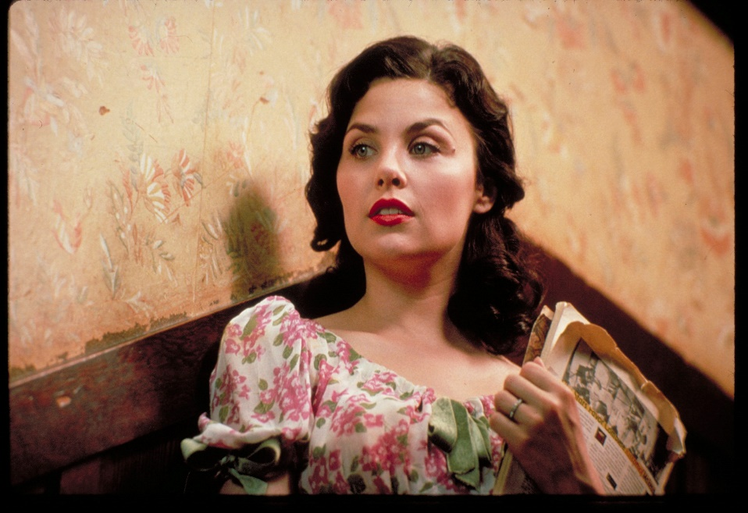
Link to Exam Paper
Focused Retrieval Strategy
Model Using Retrieval Information
Assess Using Mark Scheme
Independent Practice
Reflection
Curley’s wife
LO: to understand the character of Curley’s wife and her role in the story.
How is Curley’s wife presented throughout the novella?
Create a mind map of everything you know about Curley’s wife.
Notes:
Starter/UTV:

Slide 13
Link to Exam Paper
Focused Retrieval Strategy
Model Using Retrieval Information
Assess Using Mark Scheme
Independent Practice
Reflection
Curley’s wife
LO: to understand the character of Curley’s wife and her role in the story.
How is Curley’s wife presented throughout the novella?
Curley’s wife
Notes:
Starter/UTV:

Slide 14
Link to Exam Paper
Focused Retrieval Strategy
Model Using Retrieval Information
Assess Using Mark Scheme
Independent Practice
Reflection
Curley’s wife
LO: to understand the character of Curley’s wife and her role in the story.
Adjectives to describe her: | When she is like this:
Menacing: trying to scare others.
Seductive: tempting others in a sexual way.
Flirtatious: expressing playful sexual attraction.
Dominant: having power over others.
Racist: treating people differently because of their race or skin colour.
Hostile: treating people with dislike.
Vain: having a high opinion of your appearance.
ADD YOUR OWN | Chapter 5 – in the barn
Chapter 4 – treatment of Crooks
Chapter 2 – in the bunkhouse
Chapter 2 – in the bunkhouse
Chapter 4 – treatment of Crooks
Add to your mind map!
Chapter 4 – treatment of Crooks
Chapter 4 – treatment of Crooks
Chapter 2 – in the bunkhouse
Notes:
Starter/UTV:

Slide 15
Link to Exam Paper
Focused Retrieval Strategy
Model Using Retrieval Information
Assess Using Mark Scheme
Independent Practice
Reflection
LO: to understand the character of Curley’s wife and her role in the story.
Curley’s wife
Do you think Curley’s wife is happy?
Do you think she had much choice when it came to marrying Curley and living on the ranch?
Why might we feel sympathy for her?
Notes:
Starter/UTV:

Slide 16
Link to Exam Paper
Focused Retrieval Strategy
Model Using Retrieval Information
Assess Using Mark Scheme
Independent Practice
Reflection
LO: to understand the character of Curley’s wife and her role in the story.
Curley’s wife
Look again at this quotation from Chapter 4:
“Well I ain’t giving you no trouble. Think I don’t like to talk to somebody ever’ once in a while? Think I like to stick in that house alla time?”
How might Steinbeck have wanted us to feel about Curley’s wife? Can you link your answer to context?
Notes:
Starter/UTV:

Slide 17
Link to Exam Paper
Focused Retrieval Strategy
Model Using Retrieval Information
Assess Using Mark Scheme
Independent Practice
Reflection
LO: to understand the character of Curley’s wife and her role in the story.
Methods
Connotations
“Well I ain’t giving you no trouble. Think I don’t like to talk to somebody ever’ once in a while? Think I like to stick in that house alla time?”
Effects on the reader
Writer’s intentions
Notes:
Starter/UTV:

Slide 18
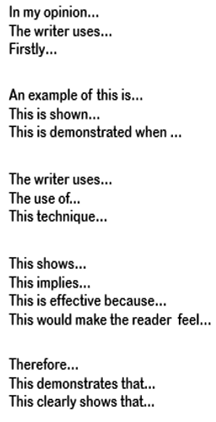
Link to Exam Paper
Focused Retrieval Strategy
Model Using Retrieval Information
Assess Using Mark Scheme
Independent Practice
Reflection
Clearly sum up your opinion you are exploring in your paragraph
LO: to understand the character of Curley’s wife and her role in the story.
How does Steinbeck present Curley’s wife?
Embed a relevant quotation to support the point you are making
Identify the technique the writer has used, including key terminology
Analyse your quotation thoroughly by considering the author and reader
Finally, link this paragraph back to the question!
Notes:
Starter/UTV:

Slide 19
Link to Exam Paper
Focused Retrieval Strategy
Model Using Retrieval Information
Assess Using Mark Scheme
Independent Practice
Reflection
Clearly sum up your opinion you are exploring in your paragraph
Curley’s wife is a character who reflects the sexism of 1930s America. In the novel, she is presented as…
LO: to understand the character of Curley’s wife and her role in the story.
Embed a relevant quotation to support the point you are making
We can support this with the following quotation: …
Identify the technique the writer has used, including key terminology
Steinbeck has used a … here.
Analyse your quotation thoroughly by considering the author and reader
This helps us to understand … as … has connotations of…
Finally, link this paragraph back to the question!
The reader may feel that Curley’s wife deserves our sympathy as…
Notes:
Starter/UTV:

Slide 20
Link to Exam Paper
Focused Retrieval Strategy
Model Using Retrieval Information
Assess Using Mark Scheme
Independent Practice
Reflection
Clearly sum up your opinion you are exploring in your paragraph
LO: to understand the character of Curley’s wife and her role in the story.
How does Steinbeck present Curley’s wife?
Embed a relevant quotation to support the point you are making
Identify the technique the writer has used, including key terminology
Analyse your quotation thoroughly by considering the author and reader
Finally, link this paragraph back to the question!
Notes:
Starter/UTV:

Slide 21
Link to Exam Paper
Focused Retrieval Strategy
Model Using Retrieval Information
Assess Using Mark Scheme
Independent Practice
Reflection
Curley’s wife
LO: to understand the character of Curley’s wife and her role in the story.
Peer assessment
Swap your work with your partner.
Read their answer and decide how well they have done the following:
Used PETAL;
Focused on Curley’s wife;
Analysed language – including connotations.
Set them a target to meet to improve their answer.
Notes:
Starter/UTV:

Slide 22
Link to Exam Paper
Focused Retrieval Strategy
Model Using Retrieval Information
Assess Using Mark Scheme
Independent Practice
Reflection
Curley’s wife
LO: to understand the character of Curley’s wife and her role in the story.
To what extent do you agree with the following statements:
The nameless Curley's wife is objectified throughout the novella.
Curley’s wife is a young, pretty woman, who is only preoccupied with her appearance.
We should pity Curley’s wife because her dreams of being a star failed.
Notes:
Starter/UTV:

Slide 23
Link to Exam Paper
Focused Retrieval Strategy
Model Using Retrieval Information
Assess Using Mark Scheme
Independent Practice
Reflection
Re-read Chapter 5.
Complete the following sheet.
Notes:
Starter/UTV:

Slide 24
Link to Exam Paper
Focused Retrieval Strategy
Model Using Retrieval Information
Assess Using Mark Scheme
Independent Practice
Reflection
LO: to understand the character of Curley’s wife and her role in the story.
Methods
Connotations
“Aw, nuts!" she said. "What kinda harm am I doin' to you? Seems like they ain't none of them cares how I gotta live.”
Effects on the reader
Writer’s intentions
Notes:
Starter/UTV:

Slide 25
Link to Exam Paper
Focused Retrieval Strategy
Model Using Retrieval Information
Assess Using Mark Scheme
Independent Practice
Reflection
Clearly sum up your opinion you are exploring in your paragraph
LO: to understand the character of Curley’s wife and her role in the story.
How does Steinbeck present Curley’s wife?
Embed a relevant quotation to support the point you are making
Identify the technique the writer has used, including key terminology
Analyse your quotation thoroughly by considering the author and reader
Finally, link this paragraph back to the question!
Notes:
Starter/UTV:

Slide 26
Link to Exam Paper
Focused Retrieval Strategy
Model Using Retrieval Information
Assess Using Mark Scheme
Independent Practice
Reflection
Clearly sum up your opinion you are exploring in your paragraph
Curley’s wife is a character who reflects the sexism of 1930s America. In the novel, she is presented as…
LO: to understand the character of Curley’s wife and her role in the story.
Embed a relevant quotation to support the point you are making
We can support this with the following quotation: …
Identify the technique the writer has used, including key terminology
Steinbeck has used a … here.
Analyse your quotation thoroughly by considering the author and reader
This helps us to understand … as … has connotations of…
Finally, link this paragraph back to the question!
The reader may feel that Curley’s wife deserves our sympathy as…
Notes:
Starter/UTV:

Slide 27
Link to Exam Paper
Focused Retrieval Strategy
Model Using Retrieval Information
Assess Using Mark Scheme
Independent Practice
Reflection
Clearly sum up your opinion you are exploring in your paragraph
LO: to understand the character of Curley’s wife and her role in the story.
How does Steinbeck present Curley’s wife?
Embed a relevant quotation to support the point you are making
Identify the technique the writer has used, including key terminology
Analyse your quotation thoroughly by considering the author and reader
Finally, link this paragraph back to the question!
Notes:
Starter/UTV:

Slide 28
Link to Exam Paper
Focused Retrieval Strategy
Model Using Retrieval Information
Assess Using Mark Scheme
Independent Practice
Reflection
Independent Learning – AP2 Revision
Notes:
Starter/UTV:

Slide 29
Link to Exam Paper
Focused Retrieval Strategy
Model Using Retrieval Information
Assess Using Mark Scheme
Independent Practice
Reflection
Independent Learning – AP2 Revision
Notes:
Starter/UTV:

