Slide 1
Year 7 AP2 Knowledge Organiser
March 2024

Slide 2
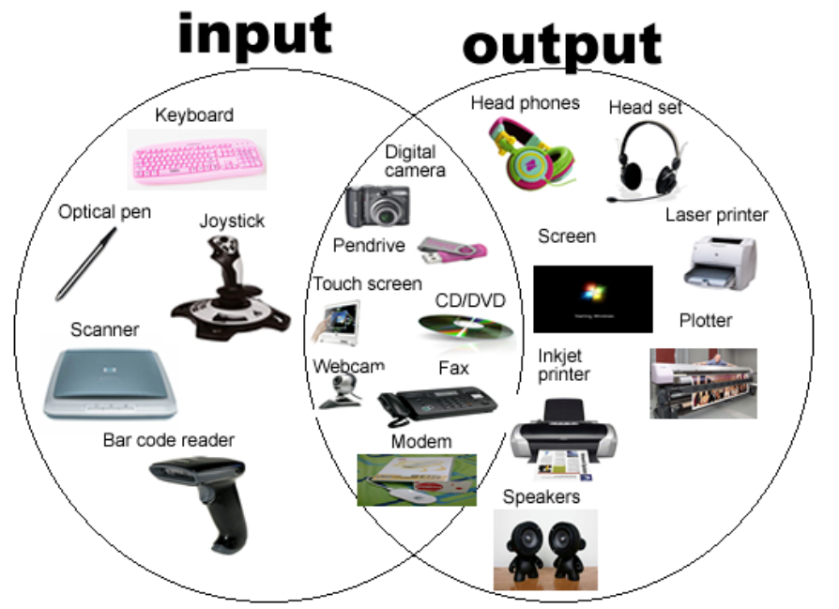
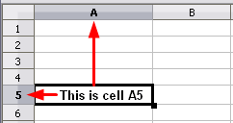
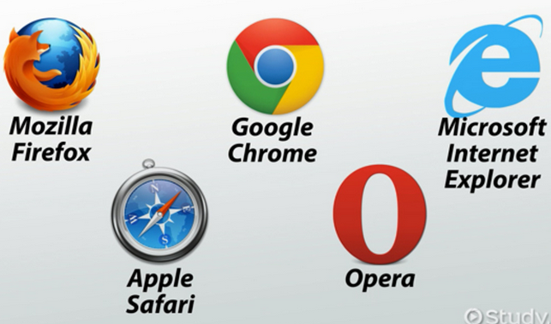
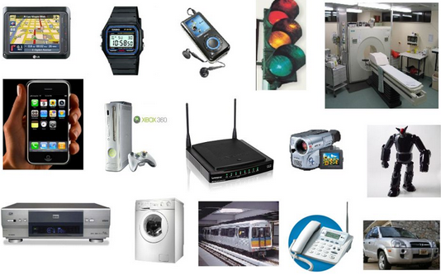
Year 7 AP2 revision topics
Cell reference
Formulas
Inputs
Outputs
Cell references (Excel)
CPU
Web browsers
Internal & External storage
Input-Process-Output
Fields (Excel)
ISP’s
Embedded computers
Portable computers
Hardware components
Difference between data and information
Primary key
Filters (Excel)
Web browsers
Embedded computers

Slide 3
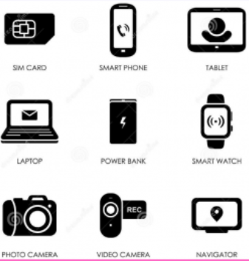
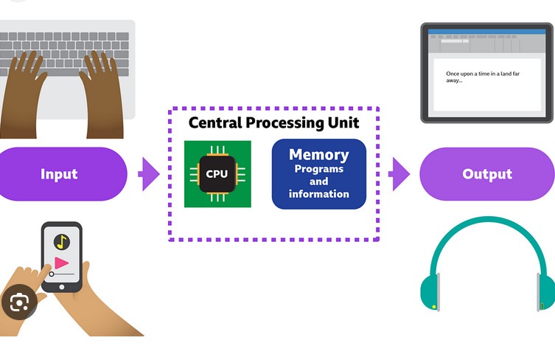
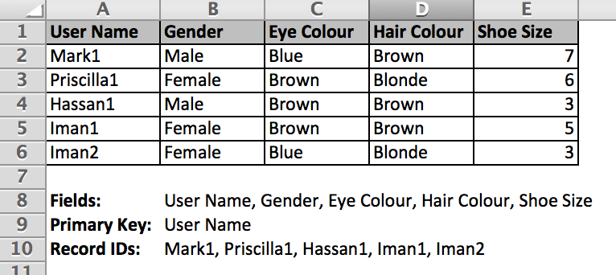
Internet service provider (ISP)
Portable computers
Input-Process-Output
Fields

Slide 4
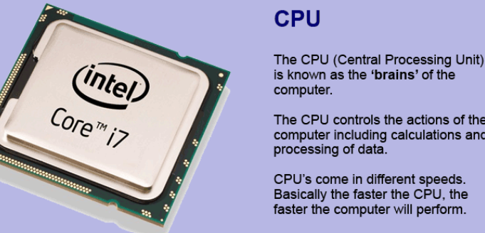
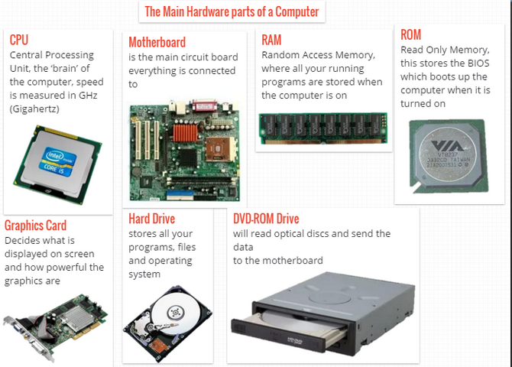
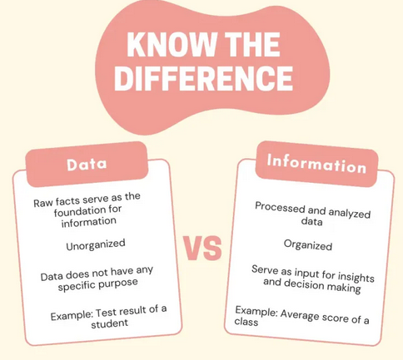
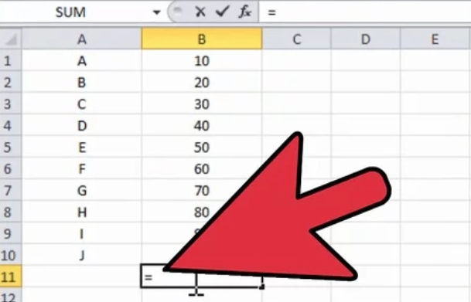
Hardware components
Data VS information
Formulas
Charting

