Slide 1
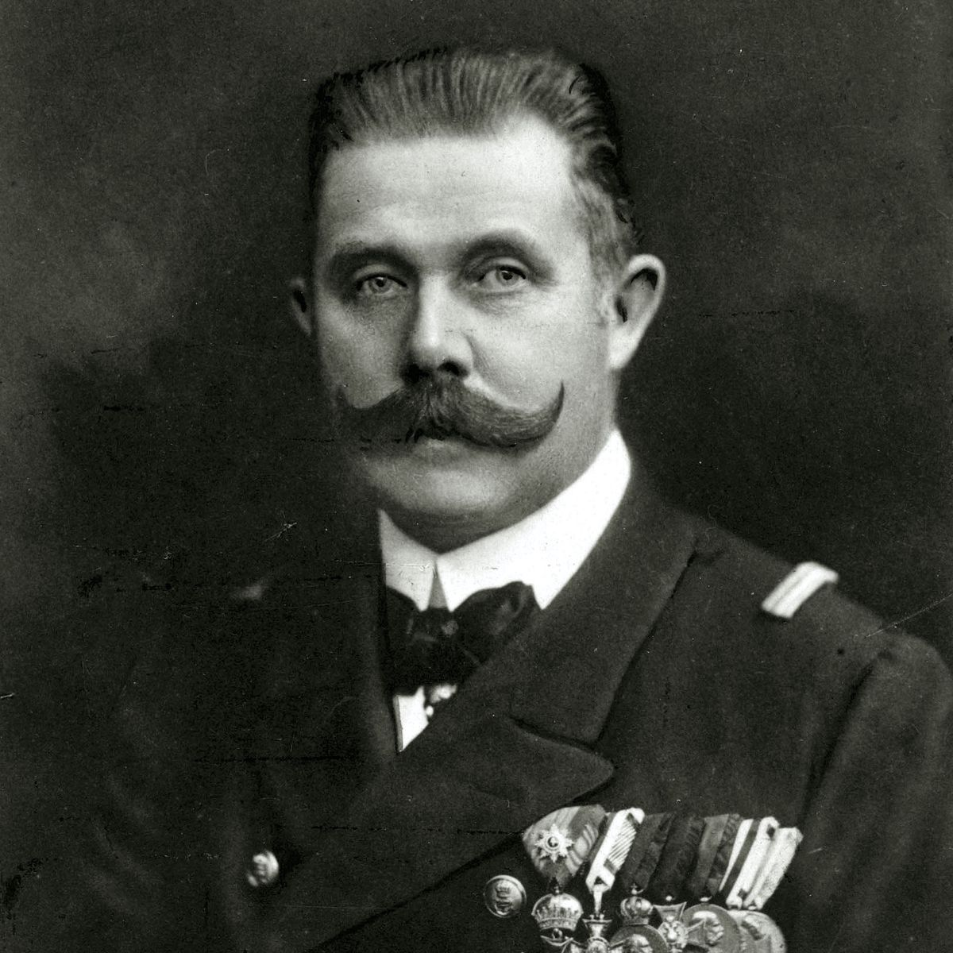
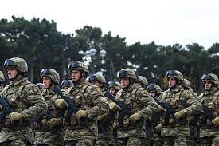
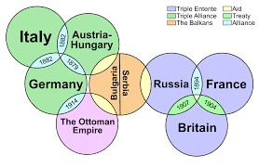
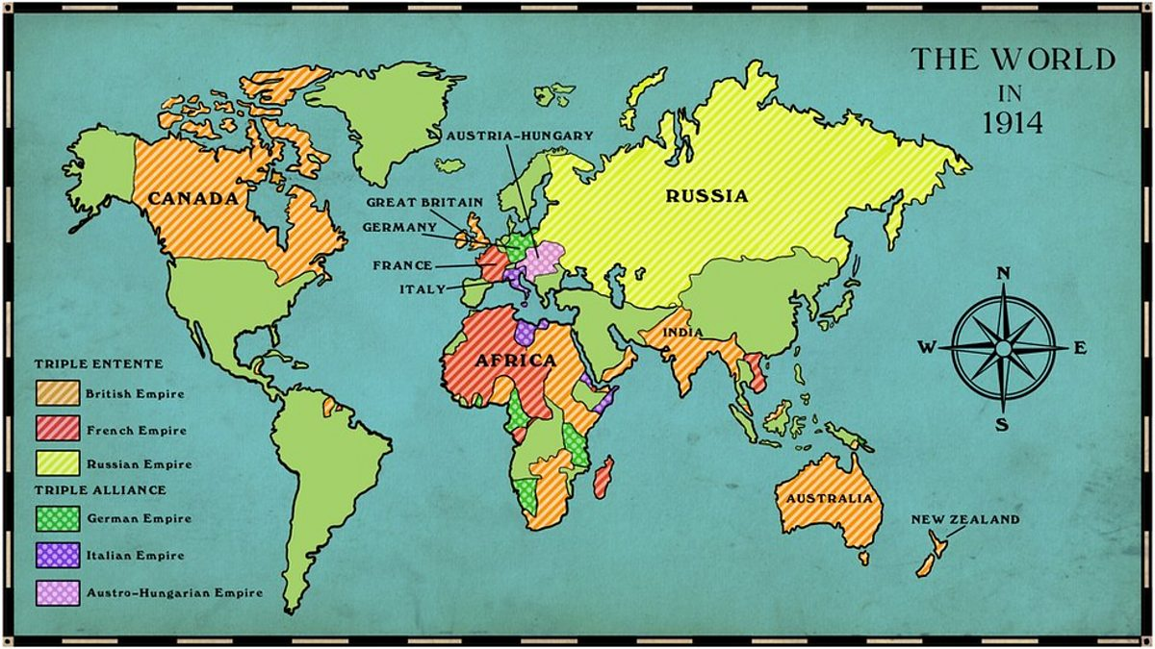
Year 9 AP2 Revision
DO NOW | LINKED LEARNING | UTV | ACTIVATE PRIOR KNOWLEDGE | EXPLICIT STRATEGY INSTRUCTION | MODELLING OF STRATEGY I DO | MEMORISATION OF STRATEGY | GUIDED PRACTICE WE DO | INDEPENDENT PRACTICE YOU DO | STRUCTURED REFLECTION
Do Now |
How many causes of WW1 can you remember? Use the picture clues below to help you.
Notes:
Competition between Empires
Alliances
Militarism – expansion of empire.
Assassination of Franz Ferdinand

Slide 2
DO NOW | LINKED LEARNING | UTV | ACTIVATE PRIOR KNOWLEDGE | EXPLICIT STRATEGY INSTRUCTION | MODELLING OF STRATEGY I DO | MEMORISATION OF STRATEGY | GUIDED PRACTICE WE DO | INDEPENDENT PRACTICE YOU DO | STRUCTURED REFLECTION
What did we learn before?
The Big Picture of Learning:
The unit we are covering is the Holocaust.
What are we going to learn today?
Today we will be revising knowledge and exam skills we will need to do well in our AP2.
What will we learn next?
We will be carrying on with our Holocaust scheme for learning.

Slide 3
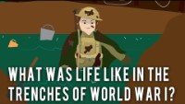
DO NOW | LINKED LEARNING | UTV | ACTIVATE PRIOR KNOWLEDGE | EXPLICIT STRATEGY INSTRUCTION | MODELLING OF STRATEGY I DO | MEMORISATION OF STRATEGY | GUIDED PRACTICE WE DO | INDEPENDENT PRACTICE YOU DO | STRUCTURED REFLECTION
What was life like in the trenches?
Notes:
See what students remember from the video and ask them to make notes under the subtitle.

Slide 4
DO NOW | LINKED LEARNING | UTV | ACTIVATE PRIOR KNOWLEDGE | EXPLICIT STRATEGY INSTRUCTION | MODELLING OF STRATEGY I DO | MEMORISATION OF STRATEGY | GUIDED PRACTICE WE DO | INDEPENDENT PRACTICE YOU DO | STRUCTURED REFLECTION
Word | Image | Definition | Word Class
Legacy |  | The long-lasting impact of particular events, actions, individuals etc. | Noun

Slide 5
DO NOW | LINKED LEARNING | UTV | ACTIVATE PRIOR KNOWLEDGE | EXPLICIT STRATEGY INSTRUCTION | MODELLING OF STRATEGY I DO | MEMORISATION OF STRATEGY | GUIDED PRACTICE WE DO | INDEPENDENT PRACTICE YOU DO | STRUCTURED REFLECTION
What were some consequences of WW2 that left legacies? Think about the events that had the biggest impacts on the public.
Notes:
Pearl Harbour – make sure students are aware of this one please.
Liberation of concentration camps.
Bombing of Hiroshima and Nagasaki
Cold War – tension between USA and USSR increases.

Slide 6
DO NOW | LINKED LEARNING | UTV | ACTIVATE PRIOR KNOWLEDGE | EXPLICIT STRATEGY INSTRUCTION | MODELLING OF STRATEGY I DO | MEMORISATION OF STRATEGY | GUIDED PRACTICE WE DO | INDEPENDENT PRACTICE YOU DO | STRUCTURED REFLECTION
What is something you don’t know about the end of WW2 that you would like to know?
How might you find out this information? What primary source could you use?
How do you think this primary source would help?

Slide 7
DO NOW | LINKED LEARNING | UTV | ACTIVATE PRIOR KNOWLEDGE | EXPLICIT STRATEGY INSTRUCTION | MODELLING OF STRATEGY I DO | MEMORISATION OF STRATEGY | GUIDED PRACTICE WE DO | INDEPENDENT PRACTICE YOU DO | STRUCTURED REFLECTION
Why is it important that we remember, and respect, the experiences of Holocaust victims when studying the Holocaust?

Slide 8
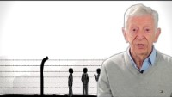
DO NOW | LINKED LEARNING | UTV | ACTIVATE PRIOR KNOWLEDGE | EXPLICIT STRATEGY INSTRUCTION | MODELLING OF STRATEGY I DO | MEMORISATION OF STRATEGY | GUIDED PRACTICE WE DO | INDEPENDENT PRACTICE YOU DO | STRUCTURED REFLECTION
Notes:
Video to help with previous slide.

Slide 9
DO NOW | LINKED LEARNING | UTV | ACTIVATE PRIOR KNOWLEDGE | EXPLICIT STRATEGY INSTRUCTION | MODELLING OF STRATEGY I DO | MEMORISATION OF STRATEGY | GUIDED PRACTICE WE DO | INDEPENDENT PRACTICE YOU DO | STRUCTURED REFLECTION
Why is it important that we write in PEEL?

Slide 10
What is something you don’t know about the end of WW2 that you would like to know?
How might you find out this information? What primary source could you use?
How do you think this primary source would help?
What is something you don’t know about the end of WW2 that you would like to know?
How might you find out this information? What primary source could you use?
How do you think this primary source would help?
Notes:
Think, pair, share.

