Slide 1
Year 8 AP2 Revision
DO NOW | LINKED LEARNING | UTV | ACTIVATE PRIOR KNOWLEDGE | EXPLICIT STRATEGY INSTRUCTION | MODELLING OF STRATEGY I DO | MEMORISATION OF STRATEGY | GUIDED PRACTICE WE DO | INDEPENDENT PRACTICE YOU DO | STRUCTURED REFLECTION
Do Now | Are these sources primary or secondary?
The Tower of London
A letter written by William of Normandy
A replica Suffragette sash.
Dover Castle
A book written by a historian about the British Empire.
Robert Falcon Scott’s diaries.
Notes:
Primary
Primary
Secondary
Primary
Secondary
Primary

Slide 2
DO NOW | LINKED LEARNING | UTV | ACTIVATE PRIOR KNOWLEDGE | EXPLICIT STRATEGY INSTRUCTION | MODELLING OF STRATEGY I DO | MEMORISATION OF STRATEGY | GUIDED PRACTICE WE DO | INDEPENDENT PRACTICE YOU DO | STRUCTURED REFLECTION
What did we learn before?
The Big Picture of Learning:
The unit we are covering is the Suffragettes
What are we going to learn today?
Today we will be revising knowledge and exam skills we will need to do well in our AP2.
What will we learn next?
We will be continuing with our Suffragettes scheme.

Slide 3
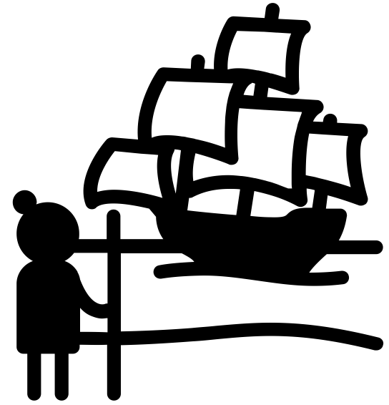
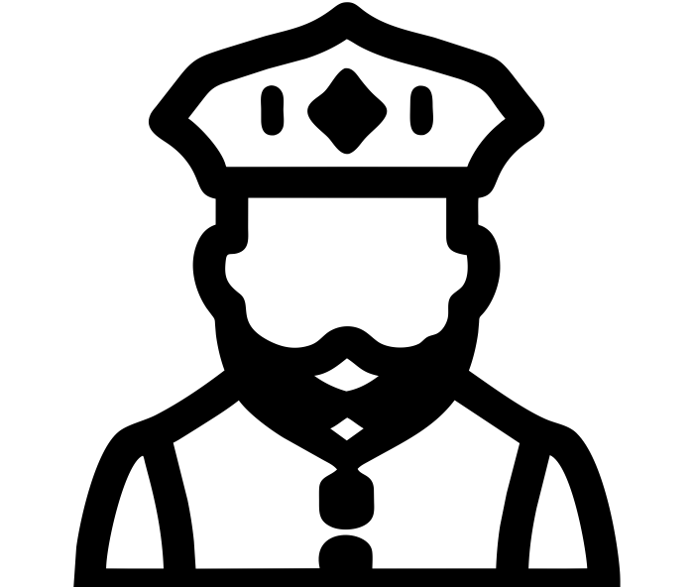
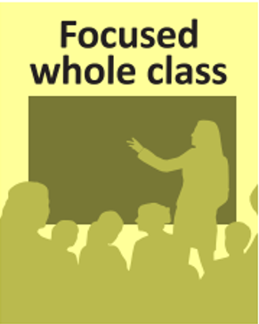
DO NOW | LINKED LEARNING | UTV | ACTIVATE PRIOR KNOWLEDGE | EXPLICIT STRATEGY INSTRUCTION | MODELLING OF STRATEGY I DO | MEMORISATION OF STRATEGY | GUIDED PRACTICE WE DO | INDEPENDENT PRACTICE YOU DO | STRUCTURED REFLECTION
Word | Image | Definition | Word Class
Colonisation |  | To take control and settle in an area usually by overpowering the current population. | Noun Colonise = verb.
Reformation |  | The process in which Henry VIII broke with the Catholic Church to create the Church of England – A form of Protestantism. | Noun Reform = verb.

Slide 4
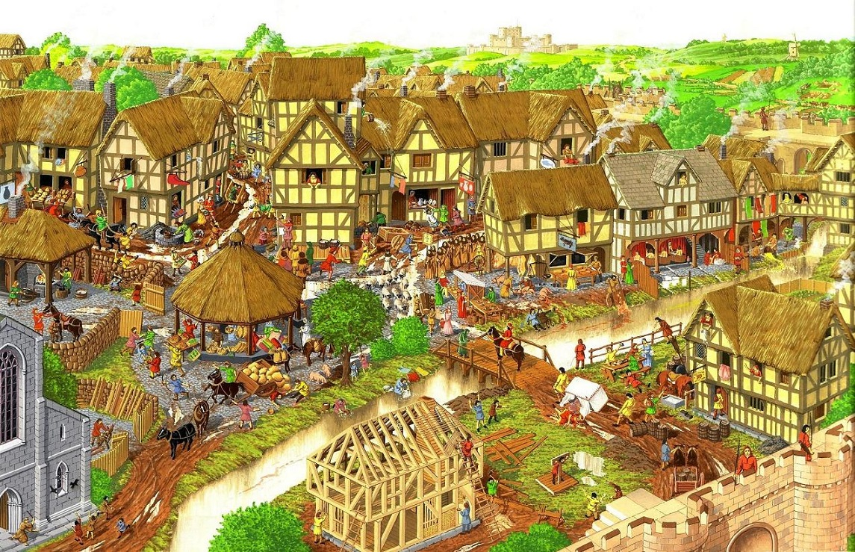
DO NOW | LINKED LEARNING | UTV | ACTIVATE PRIOR KNOWLEDGE | EXPLICIT STRATEGY INSTRUCTION | MODELLING OF STRATEGY I DO | MEMORISATION OF STRATEGY | GUIDED PRACTICE WE DO | INDEPENDENT PRACTICE YOU DO | STRUCTURED REFLECTION
What do we remember about medieval towns? How do they compare to towns today?

Slide 5
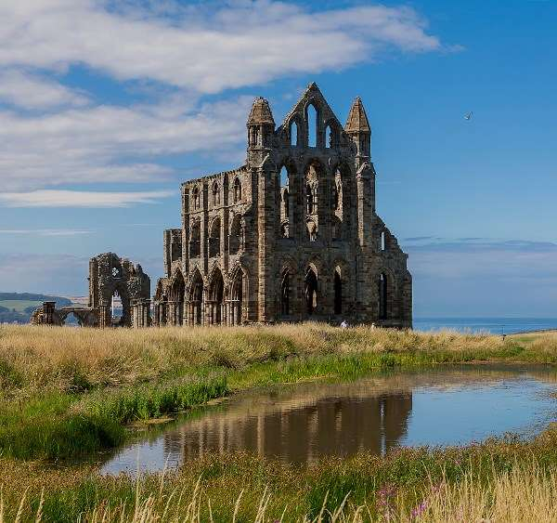
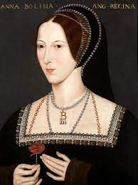
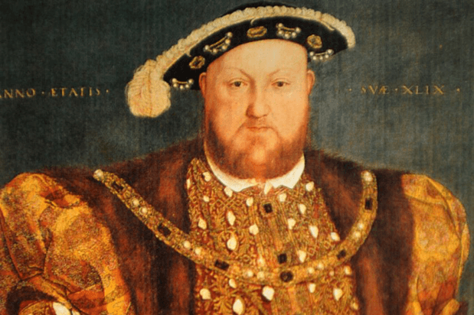
DO NOW | LINKED LEARNING | UTV | ACTIVATE PRIOR KNOWLEDGE | EXPLICIT STRATEGY INSTRUCTION | MODELLING OF STRATEGY I DO | MEMORISATION OF STRATEGY | GUIDED PRACTICE WE DO | INDEPENDENT PRACTICE YOU DO | STRUCTURED REFLECTION
What happened as a result of Henry VIII’s reformation of the Church in England? Why did he reform the Church?
Notes:
Henry became head of the Church rather than the Pope.
Divorce was made legal.
Monasteries were dissolved (Henry stole all their money).

Slide 6
Task:
DO NOW | LINKED LEARNING | UTV | ACTIVATE PRIOR KNOWLEDGE | EXPLICIT STRATEGY INSTRUCTION | MODELLING OF STRATEGY I DO | MEMORISATION OF STRATEGY | GUIDED PRACTICE WE DO | INDEPENDENT PRACTICE YOU DO | STRUCTURED REFLECTION
Read through the fact file about Mansa Musa.
Highlight things that he did that you consider to be important.
What do we learn from Interpretation 1 about Mansa Musa? 1 x Inference and 1 x Supporting Detail.
Challenge: What might you like to find out about Mansa Musa that you haven’t learnt from the info sheet?

Slide 7
How did India change as a result of British colonisation?
DO NOW | LINKED LEARNING | UTV | ACTIVATE PRIOR KNOWLEDGE | EXPLICIT STRATEGY INSTRUCTION | MODELLING OF STRATEGY I DO | MEMORISATION OF STRATEGY | GUIDED PRACTICE WE DO | INDEPENDENT PRACTICE YOU DO | STRUCTURED REFLECTION
Notes:
Think, pair, share.

Slide 8
DO NOW | LINKED LEARNING | UTV | ACTIVATE PRIOR KNOWLEDGE | EXPLICIT STRATEGY INSTRUCTION | MODELLING OF STRATEGY I DO | MEMORISATION OF STRATEGY | GUIDED PRACTICE WE DO | INDEPENDENT PRACTICE YOU DO | STRUCTURED REFLECTION
Why is it important that we write in PEEL?

