Slide 1
Year 7 AP2 Revision
DO NOW | LINKED LEARNING | UTV | ACTIVATE PRIOR KNOWLEDGE | EXPLICIT STRATEGY INSTRUCTION | MODELLING OF STRATEGY I DO | MEMORISATION OF STRATEGY | GUIDED PRACTICE WE DO | INDEPENDENT PRACTICE YOU DO | STRUCTURED REFLECTION
Do Now | Put these events in chronological order:
Battle of Hastings
William I is crowned King of England
The Battle of Fulford Gate
Edward the Confessor dies
The Battle of Stamford Bridge
Challenge: Why was there a succession crisis in 1066?
There was a succession crisis in 1066 because…
Notes:
Edward the Confessor dies
Battle of Fulford Gate
Battle of Stamford Bridge
Battle of Hastings
William I crowned King of England.
There was a succession crisis because Edward died without leaving an heir, he had no children and he had supposedly promised the throne to quite a few people! William of Normandy, Harold Godwinson and Harald Hardrada.

Slide 2
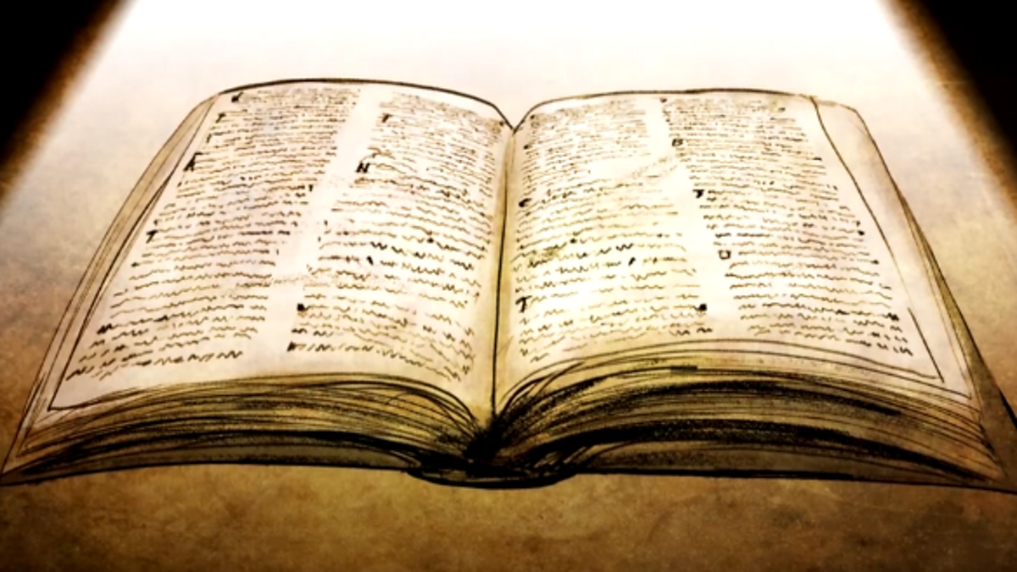
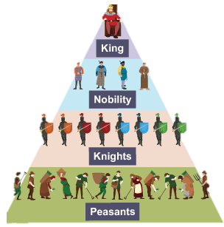
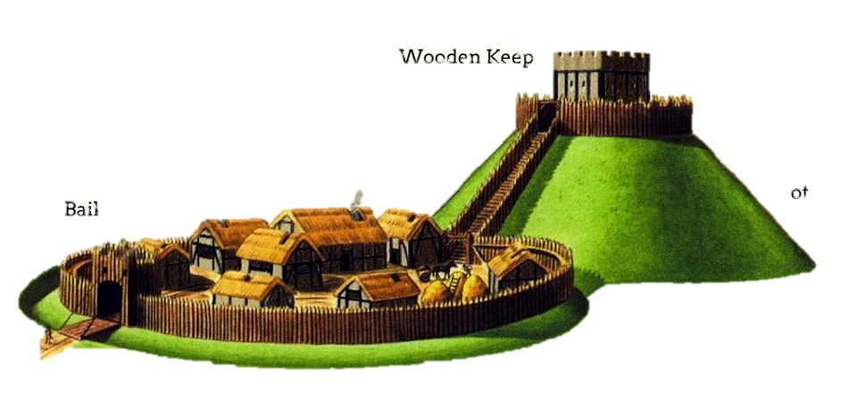
DO NOW | LINKED LEARNING | UTV | ACTIVATE PRIOR KNOWLEDGE | EXPLICIT STRATEGY INSTRUCTION | MODELLING OF STRATEGY I DO | MEMORISATION OF STRATEGY | GUIDED PRACTICE WE DO | INDEPENDENT PRACTICE YOU DO | STRUCTURED REFLECTION
How did William I establish his authority and power as King in 1066? Use the picture clues below to help you remember the four ways:
Notes:
From left to right
Doomsday Book, Motte and Bailey castles, Violence, Feudal System.

Slide 3
DO NOW | LINKED LEARNING | UTV | ACTIVATE PRIOR KNOWLEDGE | EXPLICIT STRATEGY INSTRUCTION | MODELLING OF STRATEGY I DO | MEMORISATION OF STRATEGY | GUIDED PRACTICE WE DO | INDEPENDENT PRACTICE YOU DO | STRUCTURED REFLECTION
What did we learn before?
What are we going to learn today?
Today we will be revising knowledge and exam skills we will need to do well in our AP2
What have we learnt about in our history lessons in Y7 so far?
What will we learn next?
We will be carrying on with Early Modern Europe Lessons.

Slide 4
DO NOW | LINKED LEARNING | UTV | ACTIVATE PRIOR KNOWLEDGE | EXPLICIT STRATEGY INSTRUCTION | MODELLING OF STRATEGY I DO | MEMORISATION OF STRATEGY | GUIDED PRACTICE WE DO | INDEPENDENT PRACTICE YOU DO | STRUCTURED REFLECTION
Word | Image | Definition | Word Class
Significance |  |  | Noun
Notes:
Ask students what they think significance means and write a definition together.

Slide 5
DO NOW | LINKED LEARNING | UTV | ACTIVATE PRIOR KNOWLEDGE | EXPLICIT STRATEGY INSTRUCTION | MODELLING OF STRATEGY I DO | MEMORISATION OF STRATEGY | GUIDED PRACTICE WE DO | INDEPENDENT PRACTICE YOU DO | STRUCTURED REFLECTION
Notes:
Students to watch video and make notes, mind-map?
Maybe you could see what they remember about the Magna Carta before watching the video.

Slide 6
DO NOW | LINKED LEARNING | UTV | ACTIVATE PRIOR KNOWLEDGE | EXPLICIT STRATEGY INSTRUCTION | MODELLING OF STRATEGY I DO | MEMORISATION OF STRATEGY | GUIDED PRACTICE WE DO | INDEPENDENT PRACTICE YOU DO | STRUCTURED REFLECTION
Using what you have learnt from the video, think about: Why is the Magna Carta still significant today? Can you tell the person next to you?
Notes:
Use info from the video.
Please make sure students have two reasons for significance written down.

Slide 7
DO NOW | LINKED LEARNING | UTV | ACTIVATE PRIOR KNOWLEDGE | EXPLICIT STRATEGY INSTRUCTION | MODELLING OF STRATEGY I DO | MEMORISATION OF STRATEGY | GUIDED PRACTICE WE DO | INDEPENDENT PRACTICE YOU DO | STRUCTURED REFLECTION
What are some similarities and differences between the medieval and modern towns?
Similarities | Differences
Both medieval and modern towns are used for trade. People buy and sell things. | Modern towns are much cleaner as people are paid to collect rubbish and clean the streets.

Slide 8
Source Skills
DO NOW | LINKED LEARNING | UTV | ACTIVATE PRIOR KNOWLEDGE | EXPLICIT STRATEGY INSTRUCTION | MODELLING OF STRATEGY I DO | MEMORISATION OF STRATEGY | GUIDED PRACTICE WE DO | INDEPENDENT PRACTICE YOU DO | STRUCTURED REFLECTION
Complete the worksheet provided to practice your source skills!
Challenge: What sources could we use to find out more about the medieval period? Can you give examples of both primary and secondary sources we could use? Examples of sources we could use to find out more about the medieval period are…
Notes:
Worksheet in folder.

Slide 9
How do we write PEEL Paragraphs?
DO NOW | LINKED LEARNING | UTV | ACTIVATE PRIOR KNOWLEDGE | EXPLICIT STRATEGY INSTRUCTION | MODELLING OF STRATEGY I DO | MEMORISATION OF STRATEGY | GUIDED PRACTICE WE DO | INDEPENDENT PRACTICE YOU DO | STRUCTURED REFLECTION
Notes:
Talk this through with students
Point – Outline
Evidence – provide additional info for point
Explain – why your evidence allows you to answer the question
Link – Refer back to Q.
What should they include for each part of PEEL etc.
You can use an example question if this would help.

Slide 10
Similarities | Differences
Both medieval and modern towns are used for trade. People buy and sell things. | Modern towns are much cleaner as people are paid to collect rubbish and clean the streets.
Notes:
To print for students if needed.

Slide 11
DO NOW | LINKED LEARNING | UTV | ACTIVATE PRIOR KNOWLEDGE | EXPLICIT STRATEGY INSTRUCTION | MODELLING OF STRATEGY I DO | MEMORISATION OF STRATEGY | GUIDED PRACTICE WE DO | INDEPENDENT PRACTICE YOU DO | STRUCTURED REFLECTION
Why is it important that we write in PEEL?

